Slide 1


Slide 2
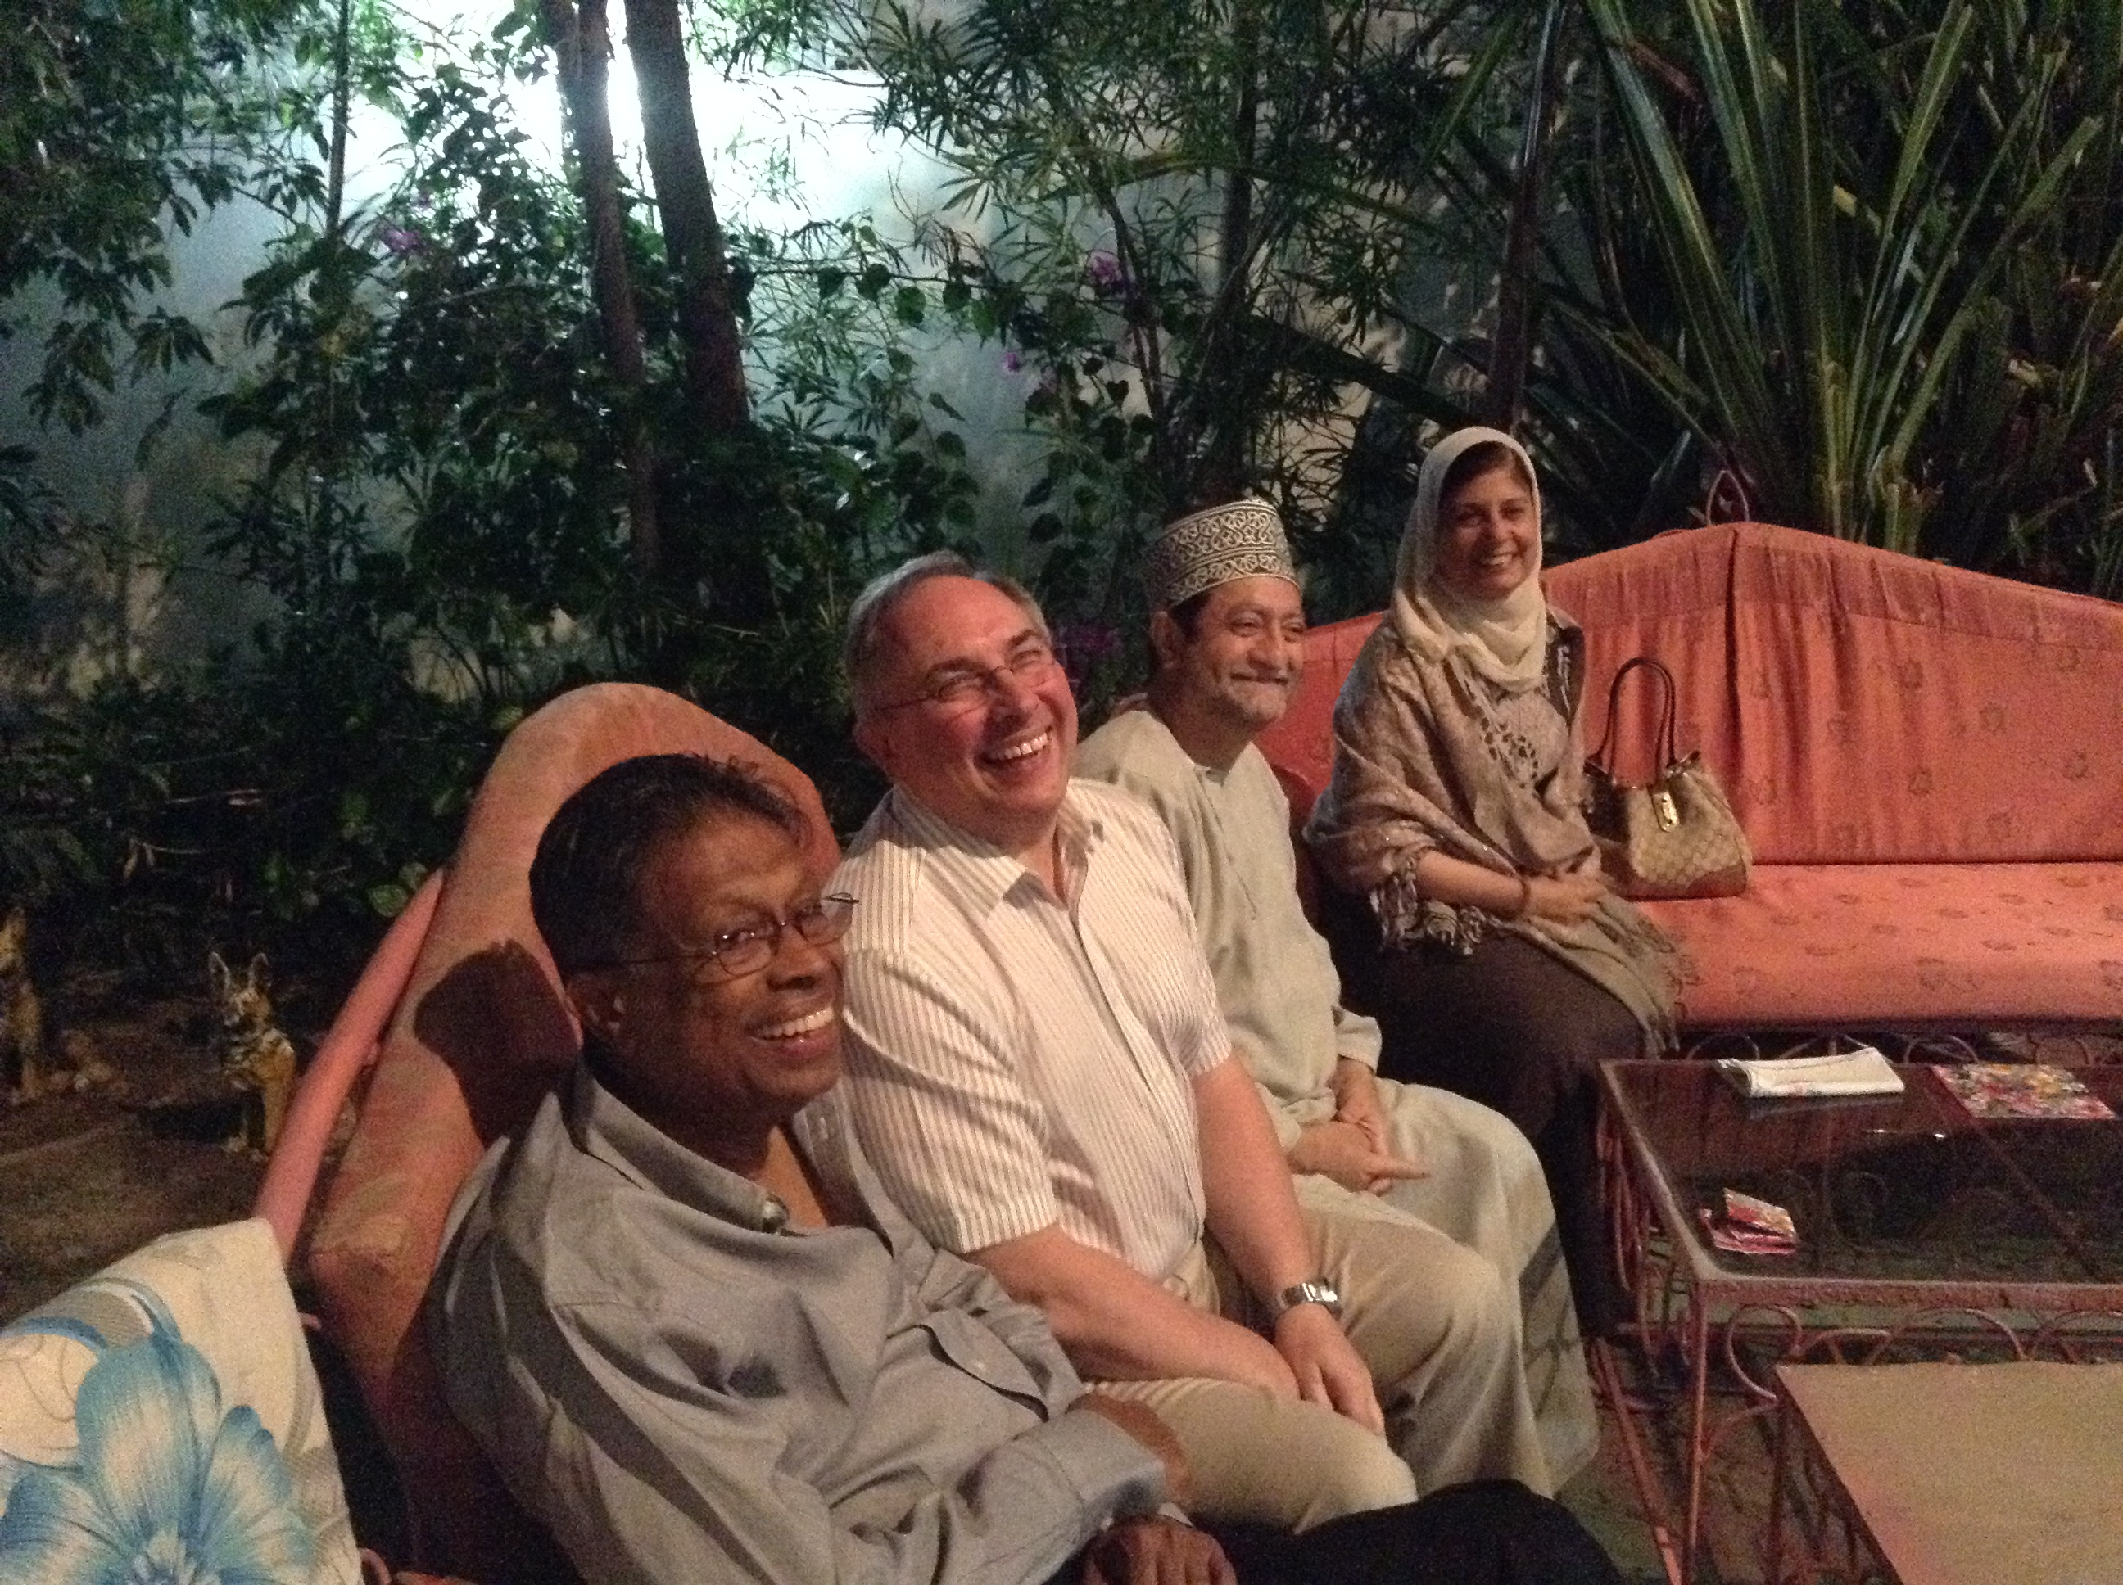
The need to communicate
David Taylor

Slide 3


To communicate with me
The Reverend Dr David CM Taylor
Reader in Medical Education
Cedar House 4:27
dcmt@liverpool.ac.uk
http://www.liverpool.ac.uk/~dcmt

Slide 4
Sources
Alberts et al., 4th Edition Essential Cell Biology (2014) Garland Science (Chapter 12)
Lippincott’s Illustrated Reviews:Physiology (2012) Preston, RR and Wilson, TE. Lippincott
Medical Sciences,2nd Edition (2014) Edited by Naish, J and Syndercombe Court, D. Elsevier

Slide 5
To start with the obvious
We are made up of cells
But they clearly stick together
and work together
In the next couple of lectures we will start to explore the mechanisms they use.

Slide 6
Cell differentiation
There are many types of cell
They all start out as stem cells
And differentiate into cells with different and specific functions.

Slide 7
Cell differentiation continued…
In almost all cases the cells continue to do what they are supposed to do
And stay in the place that they are supposed to be in
One of the really big questions is how they “know” what they should do

Slide 8
Short answer
The short answer is that they communicate with each other
But how?

Slide 9
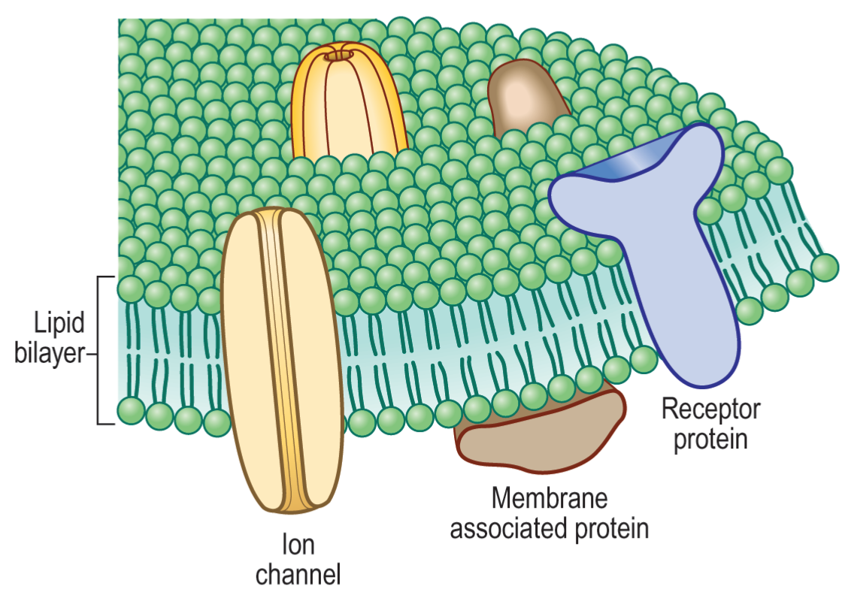
First
Remember what the membrane looks like
Fig 2.28 in Naish
1st edition

Slide 10
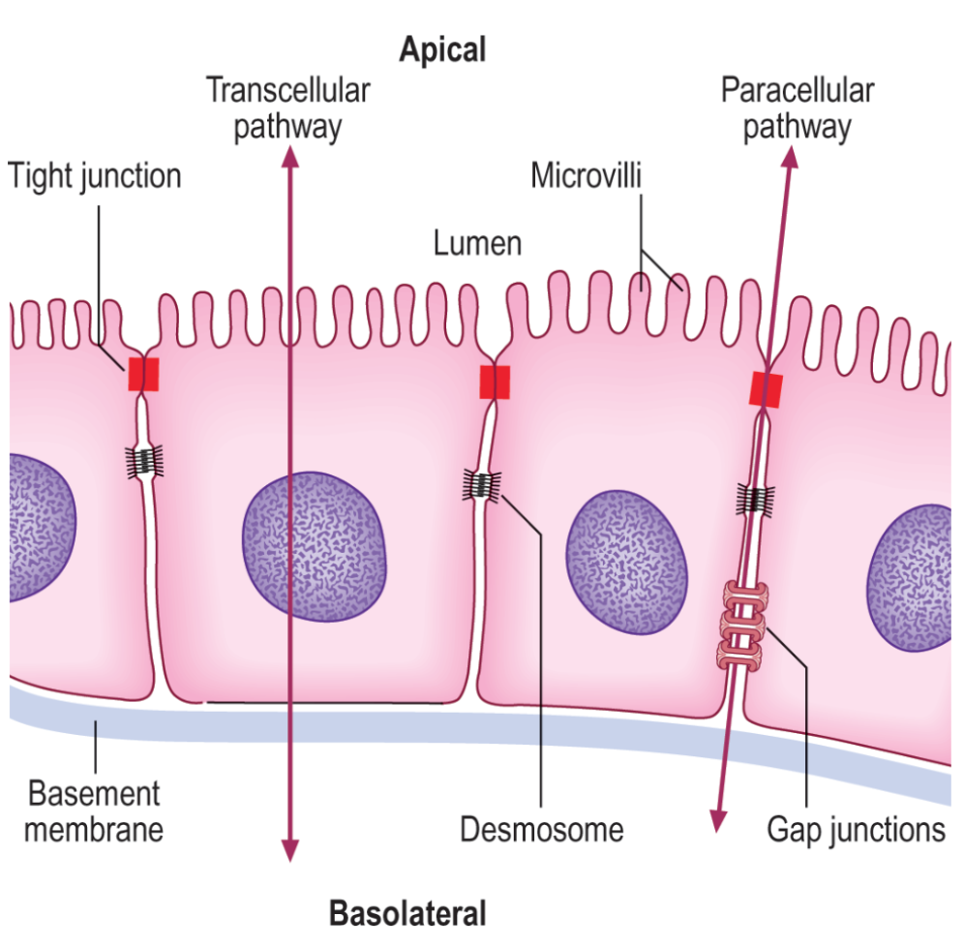
Direct communication
Tight junction
prevents
Desmosome
joins
Gap junction
communicates
Fig 2.29 in Naish
1st edition

Slide 11
Tight junctions
Form a belt around the cell, anchoring it to neighbouring cells.
NOT attached to the cytoskeleton
The belt stops membrane proteins moving past it.
And stops molecules diffusing across the tissue

Slide 12
Desmosomes
Anchor cells together
ARE attached to cytoskeleton
Cadherins form the links between the “plaques” in the individual cells

Slide 13
Gap Junctions
Are channels or bridges between cells formed from connexins.
They allow small molecules and ions to pass between cells.
So small chemical and electrical signals can pass through them.
This is how electrical signals pass through smooth muscle.

Slide 14
Chemical communication
A chemical is released which binds to a receptor on a cell membrane (or sometimes inside the cell). The chemical may travel a very short distance, or a long distance.

Slide 15
Paracrine and Autocrine
Paracrine
Autocrine

Slide 16
examples
Paracrine
Nitric Oxide
  Local vasodilator released from endothelial cells
Autocrine
Prostaglandins
  Inflammatory mediators

Slide 17
Neural and endocrine
Electrical signal
Neural
neurotransmitter
Blood
Hormone
Endocrine

Slide 18
Neural examples
Neural
Glutamate
  excitatory in CNS
Acetylcholine
  Excites skeletal muscle
Noradrenaline
  Causes vasoconstriction

Slide 19
Hormones
The chemical type usually reflects the way that they act on the target tissues
  Amino acid derivatives
  Steroids
  Peptides
  Proteins
  Glycoproteins

Slide 20
Amino acid derivatives
Adrenaline and noradrenaline
  “catecholamines”, circulate free or weakly bound to albumin, short half-life. Bind to G-protein coupled receptors
Thyroid hormones (T3 and T4)
  Circulate bound to plasma proteins. Long half lives. Transported through membranes and bind to nuclear receptors

Slide 21
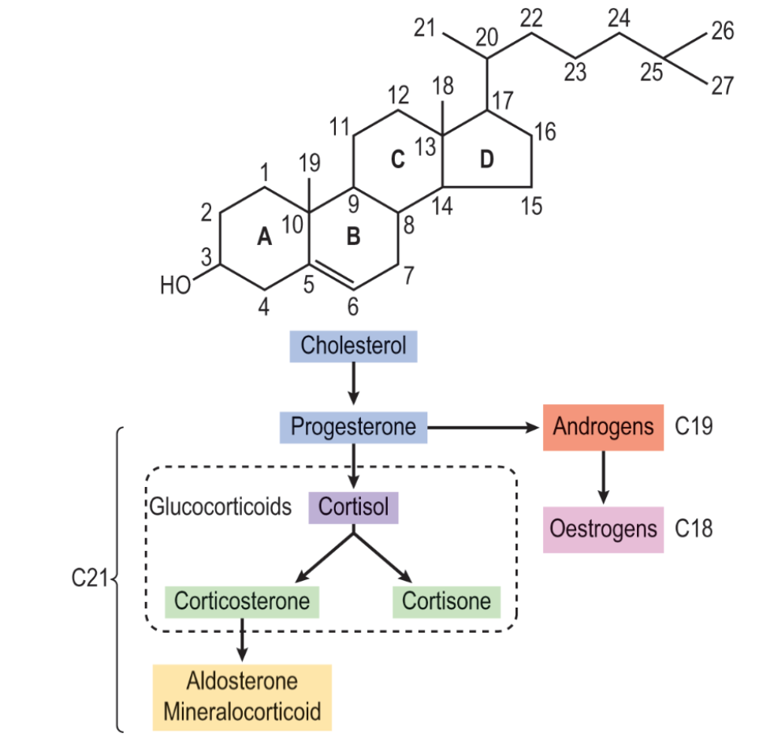
Steroids
Oestrogens, androgens aldosterone etc.,
Circulate bound to plasma proteins, but readily diffuse through cell membrane. Bind to intracellular steroid receptors
Figure 10.1 from
Naish 1st Edition

Slide 22
Peptides etc.,
Peptides, proteins and glycoproteins
Are usually carved from prohormones when needed
Then are secreted by exocytosis
And do not usually bind to plasma proteins.
They are very different in structure so their effects are mediated by several different mechanisms (see next lecture)

Slide 23
Peptides
Thyrotropin releasing factor (TRH)
Gonadotrophin releasing hormone (GnRH)
Adrenocorticotropic hormone (ACTH)
Antidiuretic hormone (ADH, Vasopressin)
Oxytocin
Glucagon
Somatostatin
Vasoactive intestinal polypeptide (VIP)

Slide 24
Proteins
Insulin
Insulin-like growth factors (IGFs)
Growth Hormone (GH)
Prolactin (PRL)
Placental Lactogen(PL)
Parathyroid hormone (PTH)

Slide 25
Glycoproteins
Proteins which are glycosylated
Thyroid Stimulating Hormone (TSH)
Follicle stimulating hormone (FSH)
Luteinising Hormone (LH)
Chorionic gonadotrophin (hCG)

Slide 26
This year
You will be looking at the way:
Insulin, glucagon, grehlin, leptin etc control glucose, lipids and metabolism
The renin-angiotensin/aldosterone system controls blood pressure
Hormones control reproduction
And probably many other examples, which show the importance of hormones in normal life and development.

Slide 27
Ligand/receptor
The molecule that is the signal is called a ligand.
It binds to a receptor which triggers the effect.
There are several types of receptor, and we will focus on the main ones.

Slide 28
G-protein coupled receptors
Membrane bound
Activate other intracellular signalling processes through “second messengers”
Chapter 4 in Naish (2009 edition) is excellent, but don’t expect to understand it all at this stage!

Slide 29
G-proteins
G_{s}
stimulates adenylate cyclase
G_{i}
inhibits adenylate cyclase
G_{q}
Activates phospholipase C
Ligand
membrane
γ
Receptor
G_{s}
β
β
GTP

Slide 30
cAMP as second messenger
Ligand A
Ligand B
+
-
Adenylate cyclase
γ
γ
G
G
β
β
GTP
GTP
ATP
phosphodiesterase
cAMP
AMP
Inactive PKA
Active Protein kinase A
Protein
Protein-phosphate

Slide 31
Receptor tyrosine kinases
Receptor tyrosine kinase is a transmembrane protein which is normally inactive.
When the ligand binds (e.g. insulin), the receptor subunits aggregate, and the tyrosine molecules become phosphorylated
other intracellular proteins then bind to the tyrosine kinase and are activated

Slide 32
Nuclear receptors
Hormones like the steroid hormones are lipid soluble and can diffuse through the plasma membrane.
Inside the cell they bind to their receptors, causing a conformational change.
The conformational change allows a dimer to form
The dimer binds to recognition sites on DNA and triggers (or sometimes inhibits) transcription of specific genes

Slide 33
Ligand gated channels
A simple example is the acetylcholine receptor in muscle
Acetylcholine binds to a receptor which opens a channel to allow Na⁺ into the cell
The influx of Na⁺ depolarises the cell
The depolarisation causes the release of intracellular Ca²⁺
Which allows the actin and myosin to bind together, and contraction to occur.

Slide 34
Resting Membrane Potential
Cells in the body are mostly impermeable to Na⁺
and mostly permeable to K⁺ and Cl⁻
Intracellular proteins are negatively charged and can’t leave the cell.
When the cell is “at rest” the membrane potential is a compromise between the charge carried by the diffusible ions, and the concentration gradient for each ion
Normally this is about -90mV, or -70mV in excitable cells

Slide 35
The action potential
e.g. in neurones
+40mV
Fully permeable to Na^{+(+40mV)}
Resting membrane potential^{(-70mV)}
-55mV
-70 mV
Fully permeable to K^{+ (-90mV)}
1mS

Slide 36
The action potential
e.g. in neurones
VANC close
+40mV
Fully permeable to Na^{+(+40mV)}
VANC open
stimulus
Resting membrane potential^{(-70mV)}
-55mV
-70 mV
Fully permeable to K^{+ (-90mV)}
1mS

Slide 37
The action potential
VANC close
+40mV
Fully permeable to Na^{+(+40mV)}
VANC open
gNa⁺
gK⁺
Resting membrane potential^{(-70mV)}
stimulus
-55mV
-70 mV
Fully permeable to K^{+ (-90mV)}
1mS

Slide 38
The wave of depolarisation
+
+
+
+
+
+
+
+
+
+
-
-
-
-
-
-
-
-
-
-
-
-
+
+
+
+
+
+
+
+
+
+
-
-
-
-
-
-
-
-
+
+
-
-
+
+
+
+
+
+
-
-
+
+
-
-
-
-
-
-

Slide 39
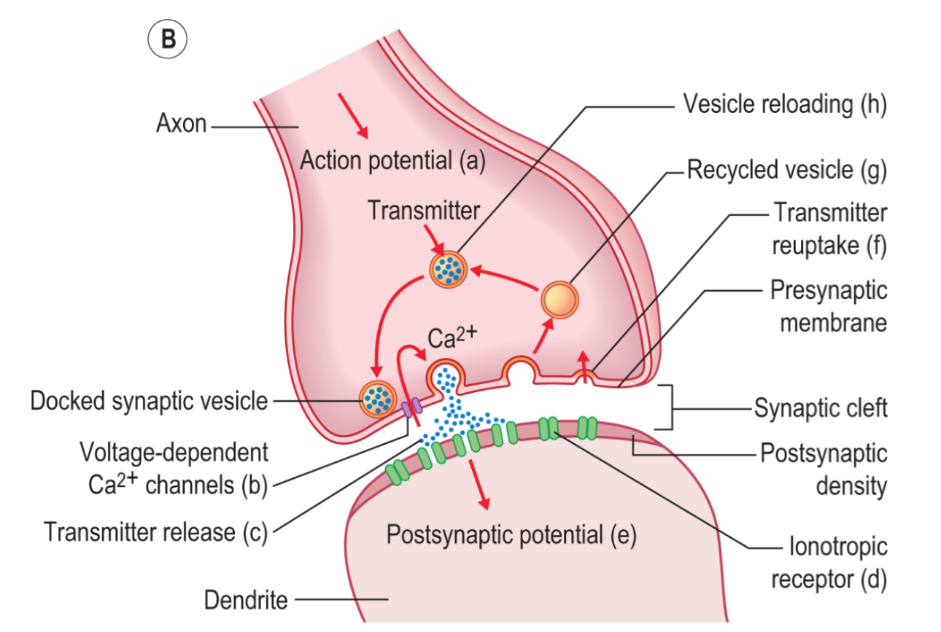
The synapse
Figure 8.22 from Naish (2009)

Slide 40
At the synapse
In response to depolarisation
Voltage-dependent Ca²⁺ channels open
Which allows vesicles containing neurotransmitters to fuse with the membrane
The neurotransmitter crosses the synaptic cleft
And binds to receptors
Which cause a post-synaptic potential…..

Slide 41
Putting it all together
neurotransmitter
Electrical signal
Neural
neurotransmitter

